Slide 1
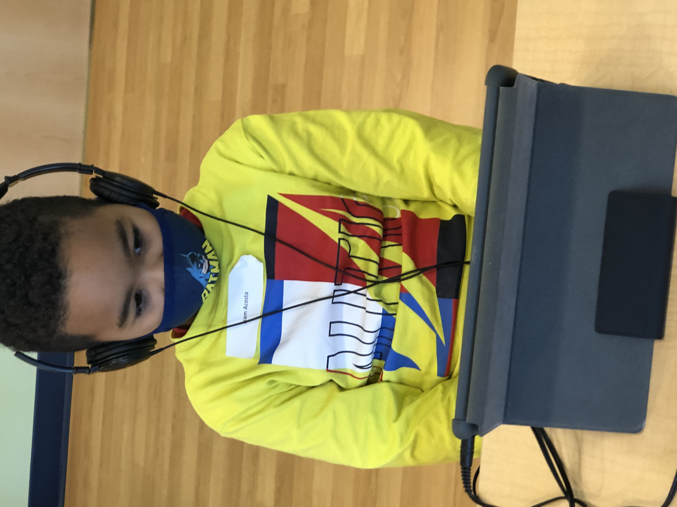
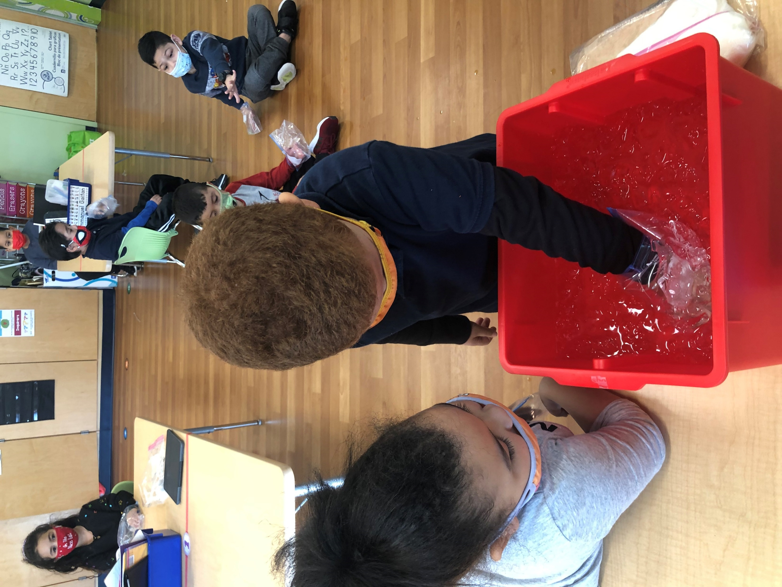
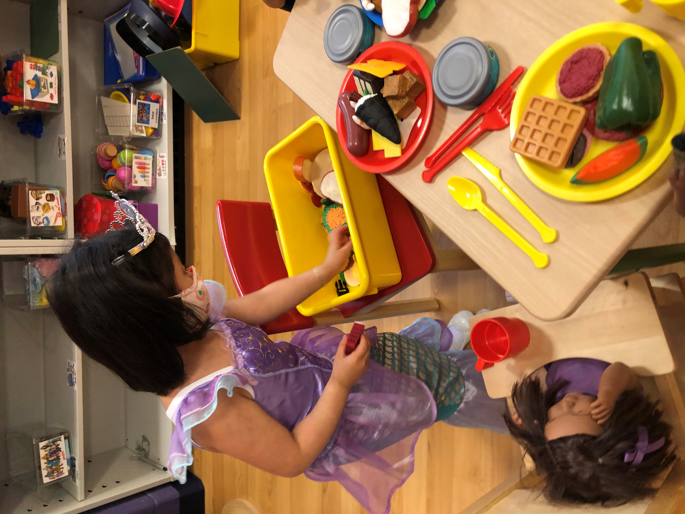
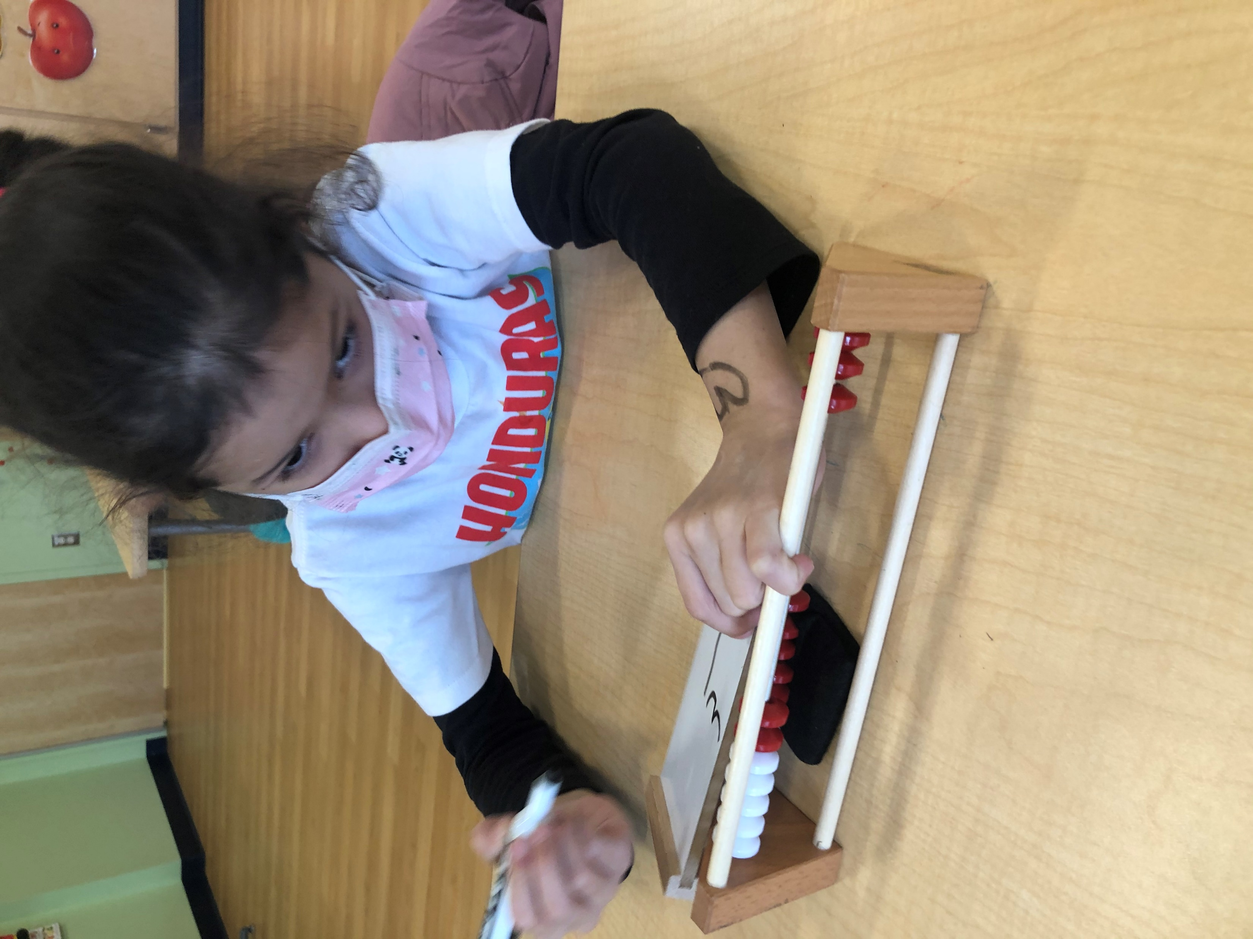
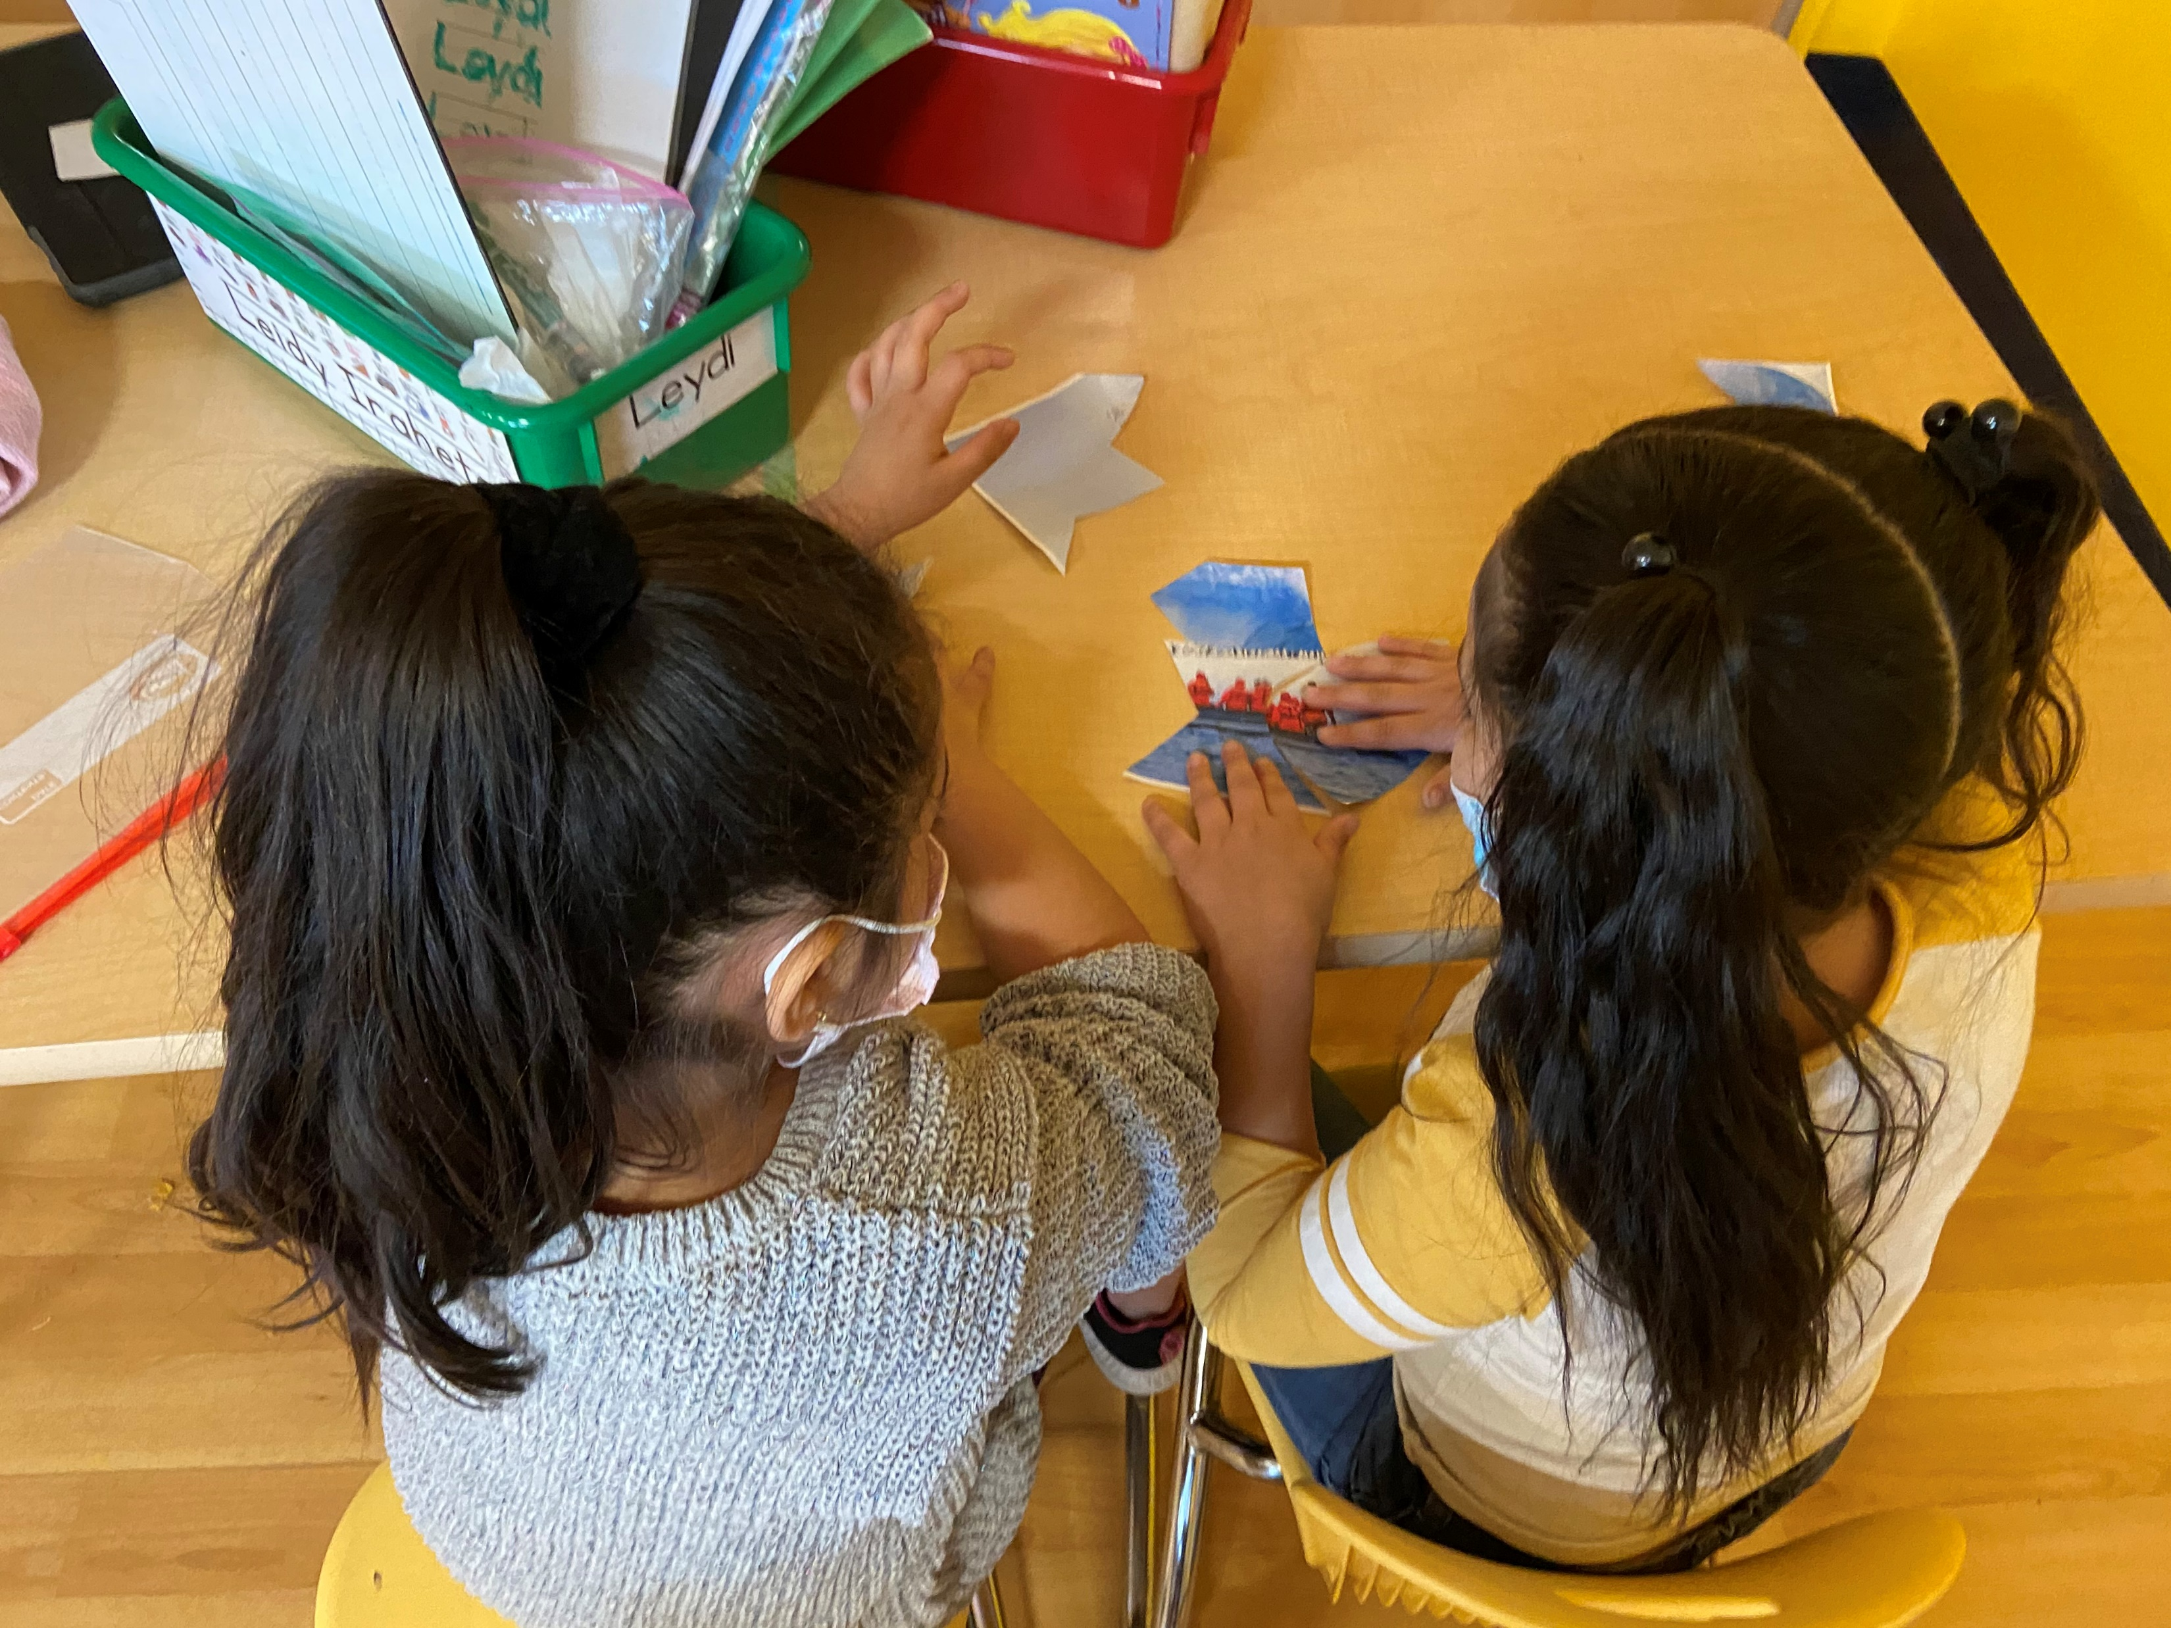
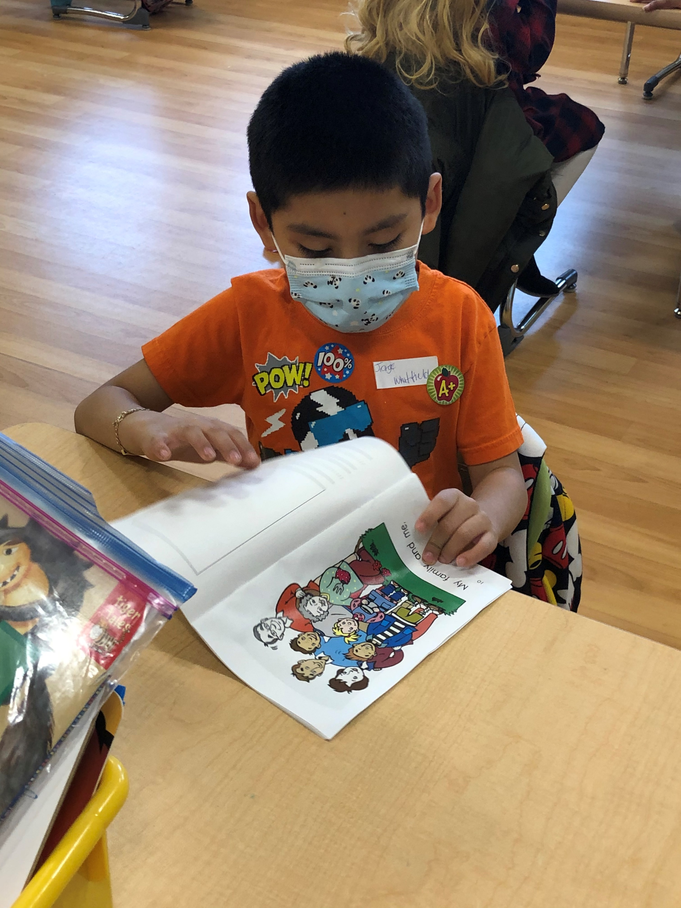
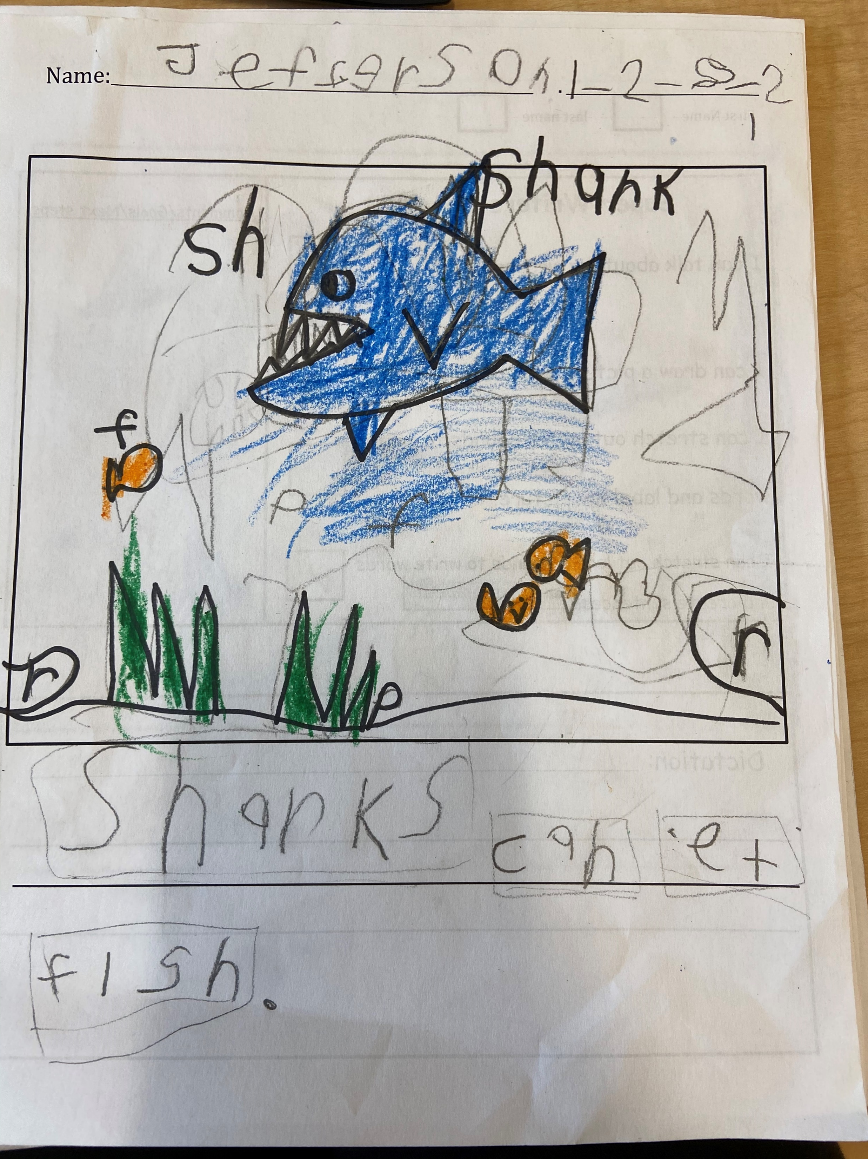
Prospect School’s IB application to become an authorized IB World School has been accepted! A virtual verification visit will review instructional practices we have established as an IB PYP Candidate School. The IB visiting team will visit classes virtually for two days, March 22-23, 2021. We are looking for parent volunteers to speak to the visiting team to share what they know about IB and the positive experience your child is having at Prospect School. If you would like additional information, please contact Ms. Chung at (516) 434-4700, via email - rchung@hempsteadschools.org or send a not to your child’s teacher.
February’s Learner Profile Attribute is Inquirer

Slide 2
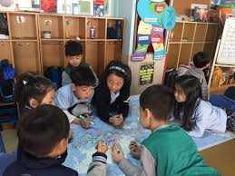
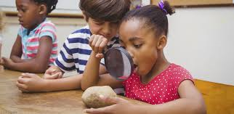
February - Learner Profile Inquirer
Students who are inquirers are curious about the world. They can conduct research independently. They love learning and discovering new things and will carry this love of learning with them throughout life.
How can parents help to develop students who are Inquirers at home?
Encourage areas of your child’s interest by visiting the library to borrow books that explore these topics.
Model being an inquirer. Admit when you don’t know the answer to a problem or a question and seek out answers in front of your child.
Encourage your child to ask questions about things they want to learn more about.
Work with your child to find solutions to problems.☺

Slide 3
Febrero: Perfil del Alumno Investigador
Estudiantes que son indagadores sienten curiosidad por el mundo. Pueden realizar investigaciones de forma independiente. Les encanta aprender y descubrir cosas nuevas y llevarán este amor por aprender con ellos durante toda la vida.
¿Cómo pueden los padres ayudar a desarrollar estudiantes que son Indagadores en casa?
Fomente las áreas de interés de su hijo visitando la biblioteca para pedir prestados libros que exploren estos temas.
Modelo siendo un investigador. Admita cuando no sepa la respuesta a un problema o una pregunta y busque respuestas frente a su hijo.
Anime a su hijo a hacer preguntas sobre cosas sobre las que quiera aprender más.
Trabaje con su hijo para encontrar soluciones a los problemas.☺

